Slide 1
Week 2: Phonetics I
EL1101E

Slide 2
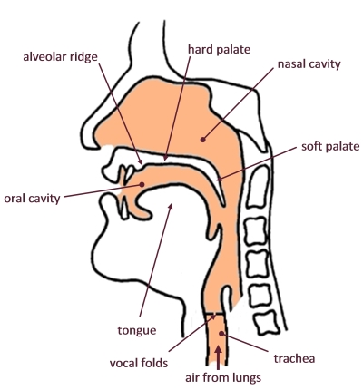
Basics of speech: The vocal tract
Can we name these locations in the vocal tract?
3
2
4
5
1
6
7
https://www.sltinfo.com/ess101-making-speech-sounds/

Slide 3
Basics of speech: The vocal tract
Can we name these locations in the vocal tract?

Slide 4
Consonant practice: what are these words?
[tʃaɪld]
[jʌŋ]
[θɪŋkərz]
[nʌkəl]
[dɪfjuʒən]

Slide 5
Consonant practice: what are these words?
[tʃaɪld] child
[jʌŋ] young
[θɪŋkərz] thinkers
[nʌkəl] knuckle
[dɪfjuʒən] diffusion

Slide 6
Consonant practice: which is the odd one out?
[v, h, w, ʃ]
[t, tʃ, p, r]
[n, m, t, s, l]
[j, w, l, g]
[m, ŋ, b, ʒ]

Slide 7
Consonant practice: which is the odd one out?
[v, h, w, ʃ] the rest are fricatives
[t, tʃ, p, r] the rest are voiceless
[n, m, t, s, l] the rest are alveolar
[j, w, l, g] the rest are approximants
[m, ŋ, b, ʒ] the rest are stops

Slide 8
Consonant practice: what is the correct IPA for the first sound of these words?
Champagne [sh, ʃ, s, tʃ]
That [t, th, θ, ð]
Giant [g, dg, dʒ, j]
Xenon [z, s, ks, x]
Julia [j, y, g, dʒ]

Slide 9
Consonant practice: what is the correct IPA for the first sound of these words?
Champagne [sh, ʃ, s, tʃ]
That [t, th, θ, ð]
Giant [g, dg, dʒ, j]
Xenon [z, s, ks, x]
Julia [j, y, g, dʒ]

Slide 10
Any other questions?

